Slide 1

Agile Software Engineering
Grooming and Planning

Slide 2
As the development process progresses, the requirements/user stories are groomed into functional input for the development teams.
The priority of the user stories and the estimates of their size are important factors when the development team is considering their commitment to the work.
This chapter presents a variety of strategies for grooming the stories.
Once the grooming is complete, the sprint planning begins, incorporating the velocity of the team, the definition of “done,” the amount of technical debt, and more.
Finally, we explore the theory of triple constraints (scope versus time versus resources) and how the management of these can affect the development process.

Slide 3
Product Backlog (Scrum and XP)
The full list of desired features, or user stories, are captured in what Scrum and XP call a “backlog.”
The highest-priority stories reside at the top of the backlog and are in the lowest level of detail.
Mike Cohn provides sound guidance on how to improve backlog quality using the acronym DEEP, which stands for Detailed appropriately, Estimated, Emergent, and Prioritized

Slide 4
Product Backlog (Scrum and XP)
Detailed appropriately means that the highest-priority stories contain sufficient detail for the development teams to deliver them: Questions are answered, and the necessary clarifications are included in the story description.
Estimated means that the team understands the stories and believes there is adequate information to estimate the level of effort or amount of time required to deliver the story. We explore estimating thoroughly in this chapter.
Emergent refers to the backlog’s constant evolution: As new information is learned about the marketplace, a competitor, or a technological advancement, the backlog is modified, reprioritized, or clarified.
Prioritized means exactly that—the user stories are in priority order, with the highest-priority items that will deliver the most business value at the top of the backlog for immediate development.

Slide 5
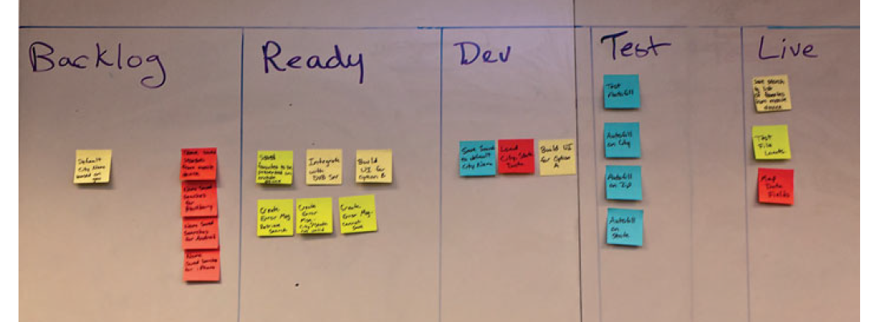
Product Backlog (Scrum and XP)
Where the product backlog is housed will vary from company to company.
Some firms, typically with smaller teams that are all colocated, may have a physical backlog with sticky notes hanging on the wall in priority order.
As collaboration between the business, product owner, and development team affects the priority, the sticky notes are simply rearranged.

Slide 6
Prioritization of Stories
As the P in the DEEP acronym, product backlog requirements/stories must be prioritized.
There are a number of tools and methods to assist with this activity.

Slide 7
Prioritization Based on Value
Targets such as increased revenue, decreased costs, and improved customer service can be the high-level objectives, but now we dive a bit deeper into the value equation.
If your competitors have a distinct advantage over you, then there are real penalties for not offering a competitive feature set.
If our weather app offers weather only in the United States but many of our executive business travelers are traveling to the UK and Mexico and our competitor offers those locations, we may risk losing customers.
Sometimes value is driven by proactively going after new markets and new opportunities.
Other times, value is derived from a more defensive or reactive posture when we are simply matching the features of our competitors.

Slide 8
Prioritization Based on Value
Value must also be supported by a positive return on investment (ROI), so the cost to deliver a desired feature must be considered.
If there is no way to recoup your investment because the cost of delivering the feature is so high, then the value deteriorates and the feature should be deprioritized.
  For example, data format for weather information in Iceland is not compatible with our application and would require a significant amount of code to convert it to a usable format.
  The cost of the data conversion compared with the revenue potential for adding Iceland data reveals that this would not be a wise undertaking and would cost far more than it is worth.
  Therefore, a user story requesting Iceland data should be removed from the backlog with the explanation for the decision.

Slide 9
Prioritization Based on Value
Lastly, there is a consideration of the risks associated with the feature development:
If this feature might jeopardize the stability of the application, then its value is diminished.
You can see that value is not a simple equation and that many factors—revenue, cost, risk, and penalties—must be considered.

Slide 10
MoSCoW
Another method of prioritization is the MoSCoW method favored by Dynamic Systems Development Method.
Must have: All features classified in this group must be implemented, and if they are not delivered, the system would simply not work.
Should have: Features of this priority are important but can be omitted if time or resources constraints appear.
Could have: These features enhance the system with greater functionality, but the timeliness of their delivery is not critical.
Want to have: These features serve only a limited group of users and do not drive the same amount of business value as the preceding items.

Slide 11
MoSCoW
Using Cayman Design as our example, we want to produce our weather related calendars for purchase to create a new revenue stream.
For this product, we have certain priorities with respect to the payment processing portion.
Must have: Ability to accept MasterCard and Visa
Should have: Add American Express and Discover
Could have: Add ACH payments for transactions directly through banking institutions
Want to have: Add gift cards

Slide 12
MoSCoW
As you can see, if we cannot accept MasterCard and Visa, then our offering is not viable; therefore, that requirement is a “must have.”
Adding American Express and Discover is important to our success, so they should be added as quickly as time allows; hence they fall into the “should have” category.
Accepting ACH payments will broaden the appeal of our product but it does not have to be delivered early in the project, so that is a “could have.”
Adding gift cards will serve only a limited audience, so that would fall into the “want to have” category.

Slide 13
Kano Model
The Kano model was introduced in 1984 by Noriaki Kano and was created to help companies learn how to build better products to “delight” the customers.
The model assists with the prioritization process because it breaks down features into three categories.
The first is basic needs, which are sometimes referred to as satisfiers/dissatisfiers.
These are the features that must be there for the product to work, in the eyes of the customer: The functionality is expected, and if it is not included, it causes great dissatisfaction.
After a consumer’s basic needs are met, then there are performance needs, which add necessary functionality to enhance the user experience.
The final category, which results in true product differentiation, consists of features that delight or excite users, and they are an unexpected bonus from the consumer’s viewpoint.

Slide 14
Kano Model
The challenge when it comes to prioritization is to focus on enough of the basic needs, performance needs, and delighters to deliver a compelling product to the marketplace.
If you have a product with only delighters but no basic needs, then you might have something really innovative that does not work.
Conversely, if you have something that satisfies every basic need but does not delight, then customers may not be compelled to buy it because it does not offer anything special or different from the competition.

Slide 15
Kano Model
Another aspect of the Kano model that is critical to understand is the evolution of the feature categorization:
Over time, delighters will become performance needs, and performance needs will become basic needs.
To illustrate this concept, think of the first iPad that you experienced. It had a number of features that delighted:
The touchscreen with the swiping capabilities was awe inspiring when first encountered, but now if we see a tablet that is not a touchscreen, it is completely dissatisfying.
The delighters have become basic needs as the competition has evolved and the technology has advanced.
Therefore, companies must continue to prioritize delighter features if they want to remain innovative.

Slide 16
Estimating
In addition to effective prioritization, grooming and planning sessions require sound estimates for how long the work is likely to take.
There are a number of different ways to come up with the estimates, just as there are many different ways to prioritize the feature requests.

Slide 17
Level of Effort (LOE) or T-Shirt Sizing
Perhaps the least precise but easiest method of estimating goes by one of the following names: “T-shirt size,” “level of effort” (LOE), or “small, medium, large.”
The last title is the most descriptive because the development team just estimates each story as small, medium, or large; teams may add extra-small and extra-large, depending on what they have decided as their measure.
The advantages of this approach are that it is very simple and can be done quickly; the disadvantages include a lack of precision and an inability to add up several stories into a meaningful measure.

Slide 18
Ideal Time (Days or Hours)
In this form of estimating, the developer determines the amount of time that a task would take under ideal circumstances—meaning no interruptions, no meetings, and no phone calls—and that is set as the ideal time.
This is an easier metric for developers to assign than actual clock time because it is difficult for them to factor in all of the possible interruptions that might occur.
Each organization will have some factor that is applied to convert ideal time to clock time; a ratio of 2 to 1 is fairly common, meaning that within every hour, 40 minutes are spent on concentrated work, with the other 20 minutes consumed by interruptions or breaks

Slide 19
Story Points
In Scrum, many teams use the concept of “story points,” which are an arbitrary measure that allows the teams to understand the size of the effort without the potentially binding expectations that come with hours.

Slide 20
Fibonacci Sequence
When estimating in story points, many teams use the Fibonacci sequence, a mathematical tool defined in the thirteenth century for rational approximations.
The sequence is the sum of the prior two numbers: 1, 2, 3, 5, 8, 13, 21;
as you can see, 1 + 2 = 3, 2 + 3 = 5, 3 + 5 = 8, and so on.
The Fibonacci sequence is helpful for Agile estimating because as the points get higher, the degree of uncertainty is increasing.
Also, many teams replace the 21 with 20 and add 40 and 100; the idea is that if a story is estimated at greater than 13 story points, there is a good chance that it is still an epic and needs to be broken down.
The difference between a 20, 40, or 100 is just a sense for the size of the epic.

Slide 21
Fibonacci Sequence
One additional thing to keep in mind is that unlike hours, which have a fixed and commonly understood definition, story points are more abstract and negotiable.
One team may assign 3 points to a story where that same story on another team would have been a 2 or a 5.
As long as everyone on the team agrees to the size of a story point, then only all of the estimating will be coherent.

Slide 22
Team Participation
How does an Agile team actually execute on the estimation process? In all instances, we are looking for participation from the developers and testers because we want to benefit from the wisdom of self-organizing teams.
Outlined next are several strategies that teams have used to come to consensus on estimation.

Slide 23
Planning Poker

